Slide 1
Creating Learner Corpora from CAST
Characterizing spoken learner texts at the upper intermediate and advanced level
Providing feedback to the learner, instructors and curriculum planners
M. Trevor Shanklin, Ph.D.

Slide 2
The CAST
http://cast.sdsu.edu
Internet-based speaking proficiency exam in 9 languages

Slide 3
CAST Rating
Accuracy
Grammar
Pragmatics
Socio-ling
Fluency
Vocab
Pron

Slide 4
CAST Rating
Function
Accuracy
Discourse

Slide 5
Grid for Selecting Items
Function -- seven
Content -- twelve

Slide 6
Methodology
Pilot study with 16 advanced EFL Students and 3 advanced Arabic speakers
Vocabulary Range
Syntactic Complexity
Realization of Function
Nvivo 8.0
GOLD at CALPER
Dragon Naturally Speaking

Slide 7
Methodology
Direct Coding of Audio Files
Cases of Individuals
Sets of Functions and Content
Transcription Tool
Imported into Nvivo 8.0

Slide 8
Methodology
Duration
Vocab Range
Word Count
Type/Token Ratio
Word Length
Frequency
Subordination
Function of Past Narrative (Past vs. Present Tense)

Slide 9
Content | Av. Duration | # Items | Repeated
Family | 2:28 | 5 | 2x 2
Travel | 2:13 | 7 | 2x 2
School | 2:09 | 4 | 1x 2
Science | 2:09 | 7 | 1 x 2
Leisure | 2:07 | 5 | 2 x 2
Health | 1:57 | 6 | 1 x 3
Bus. | 1:48 | 7 | 1 x 2, 1 x 2
Community | 1:39 | 6 | 1 x 3, 1 x 2
Pop | 1:36 | 7 | 1 x 3, 1 x 2
Work | 1:28 | 10 | 2 x 3
Art | 1:17 | 7 | 2x 2
Sport | 0:48 | 7 | 1 x 3, 1 x 2

Slide 10
Individual | Av Per Q | Av # Words | Av # Types | Words/Type R
YmtqVE1240_en | 4:04 | 460.8 | 167.8 | 0.364
JbpGeI1125_en | 2:33 | 254.2 | 104.2 | 0.410
cSUJtE1177_en | 2:30 | 297.4 | 129.2 | 0.434
CqyPcO1230_en | 2:20 | 216.4 | 85.6 | 0.396
lFfMLv1047_en* | 2:13 | 126.0 | 64.7 | 0.513
FkXZyu1250_en | 1:55 | 188.8 | 78.6 | 0.416
QCJFSC1052_en | 1:45 | 176.6 | 83.6 | 0.473
ROigHb1124_en | 1:40 | 181.2 | 75 | 0.414
qEqUJu1047_en | 1:33 | 194.4 | 70 | 0.360
kZRObu1244_en | 1:24 | 151.6 | 91.8 | 0.606
IhmZSm1099_en | 1:17 | 117.6 | 61.4 | 0.522
CPpqHv1264_en | 1:05 | 121.2 | 67.6 | 0.558
eLaUsh1269_en | 1:04 | 159.8 | 81.0 | 0.507
KRzMXq1247_en* | 0:49 | 102.8 | 70.5 | 0.686
RvfdlV1120_en | 0:45 | 80 | 46.4 | 0.580
IOLJvw1052_en | 0:45 | 83.8 | 50.6 | 0.604
Duration
Av = 1.43
Word Specificity

Slide 11
Word Count
Describe in Present Time/ Transportation
Situation:
You have just arrived at the airport of your destination. Your luggage is not in the baggage claim area. You speak with a service representative who tells you the luggage has been lost. The representative asks you to describe your luggage and its contents in detail so that the airline can reimburse you.
Prompt:
I need a description of every item in your luggage.
Student Files for YmtqVE
YmtqVE.htm

Slide 12
Student Response
A {whiles} side back, I’ll tell you the details of what it looks like. It’s black, and it’s not a metal thing. It’s kind of fabric thing. And it’s a Samsonite bag. It’s a carrier. And it’s one meter high. And kind of not big, but it’s kind of something small that I can carry easily. And there are, there are four wheels under the back. And I also tied the blue ribbon on the handle. So maybe you can recognize that at once, even though it’s black. I have several things inside the bag. Not that important things, but there are some {severed} clothes. Like t-shirts and jeans and shorts that I can wear when I\\\'m to the, when I, when I can wear it during the day time. And there’s some dresses, two -- oh no -- it was three dresses. And oh, and one dress is like, like a cute top dress with a whites gown. It’s a white gown dress. I put that in my bag and it\\\'s really important because I am going to my friend’s birthday party, so the party theme is white, so I really need that dress. So I really want that dress. It’s in my bag, even though I mean it’s not that important for for, it\\\'s not that important dress for others or, but I really need it. Cause It really fits on me. And there are some severed [several] cosmetics. Like lipsticks or {lipglows} and like my powder and my brushes and for my for my mascara for my eyelashes. Most of them are clothes and cosmetics. I also brought some, some books for my traveling. And the name is shopaholic. And it’s kind of funny book. And also there is a name tag on it. And name tag. There’s my name on it. And my name is {} So you will recognize that. And there is also my address in Korea. And also {brought} myself a number. So just those things. Clothes and cosmetics and books and my shoes, sandals and heels and flip flops. So I really want that back. It’s Samsonite. I {repeated.} So please please. I want to get it back.

Slide 13
Word Count: NVivo 8.0
Word Length, page 1 of 4

Slide 14
Word Count: NVivo 8.0
Word Length, page 4 of 4

Slide 15
Type Frequency
carrier | lipglows
cosmetics | lipsticks
cute | mascara
eyelashes | meter
fabric | samsonite
flip | sandals
flops | severed
gown | shopaholic
hagen | shorts
heels | tag
jeans | whiles
korea | whites
First 1,000 | 77 | 66%
Second 1,000 | 15 | 13%
Off List | 24 | 21%
VocabProfile
http://www.lextutor.ca/vp

Slide 16
Dragon’s Take
and analyst who heads at the hit factory and Samsonite and it's very scary and it's fun that is not in that it can something small that I can carry you and their Arab word L. hundred and Kerry tied at three Sally maybe you can recognize that not even out at him everything inside that I'm not important thing that the fabric clouds like Kerry and Jean Hewitt that I can on their say that I can write in and in and out of the street and I'll try to come back at a hot hunk and that is really weird because I don't like Britney and South are damaged by some really neat that really one that drives it and might not even that mean it's not important for you straight and not in print that were in work and in his landscapes are like clouds and Mike Hunter and Mike Roche is that most classes at night and brought him that from happening and that name is hot in that and I'll stop in a name tag and name tag there is my name and my name is taking up a little recognize that there is also an actor-and also rot under a desk that was James Clausen and that she is jealous of really one that Samsonite had an island that

Slide 17
Word Specificity in MSA
Speaker | Av duration | Word Type Av | Token AV | Av Lexical Complexity
Speaker 1 | 2:35.5 | 92 | 136 | 0.68
Speaker 2 | 2:04.1 | 74.2 | 97.2 | 0.76
Speaker 3 | 7:59.5 | 195.2 | 374.2 | 0.52
Av Total | 4:38.5 | 120.47 | 202.5 | 0.65

Slide 18
GOLD at CALPER

Slide 19
Lexical Variation
MSA | Egyptian | English
بار bar | حانة hana | bar
بسرعة bisur’a | على طول ala tool* | promptly (MSA: always)
جداً jidan | خالص khalis* | a lot (MSA: finished)
*In Egyptian dialect

Slide 20
Egyptian Dialect: Cinema
Comparison of Two Speakers

Slide 21
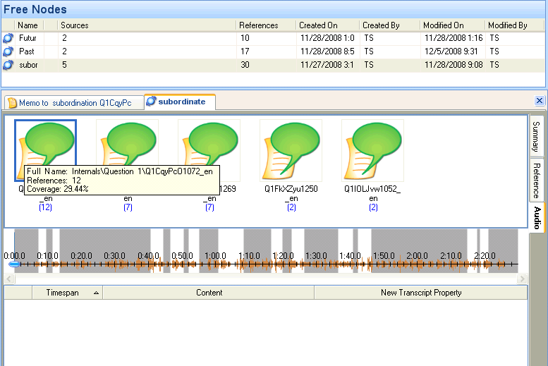
Coding Audio or Video File Directly in Nvivo 8.0

Slide 22
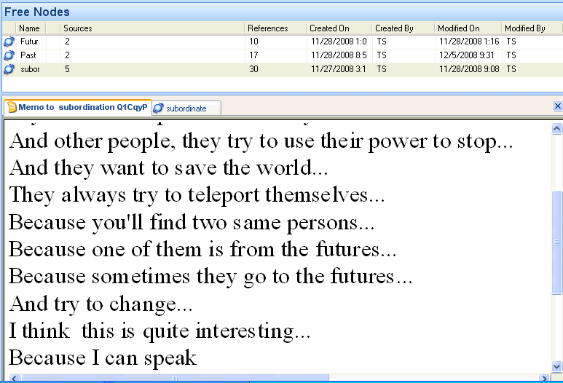
Commenting with Memo Function

Slide 23
Use of Causal Subordination
Five dimensions: features that correlate with those found in 14 spoken and written registers.
27 -- causal adverbial subordination -- clusters with ‘framing elaboration’.
=conversations, interviews and personal letters and spontaneous speakers , among others.
≠‘reference elaboration’, where official documents, academic prose and professional letters correlate very highly.

Slide 24
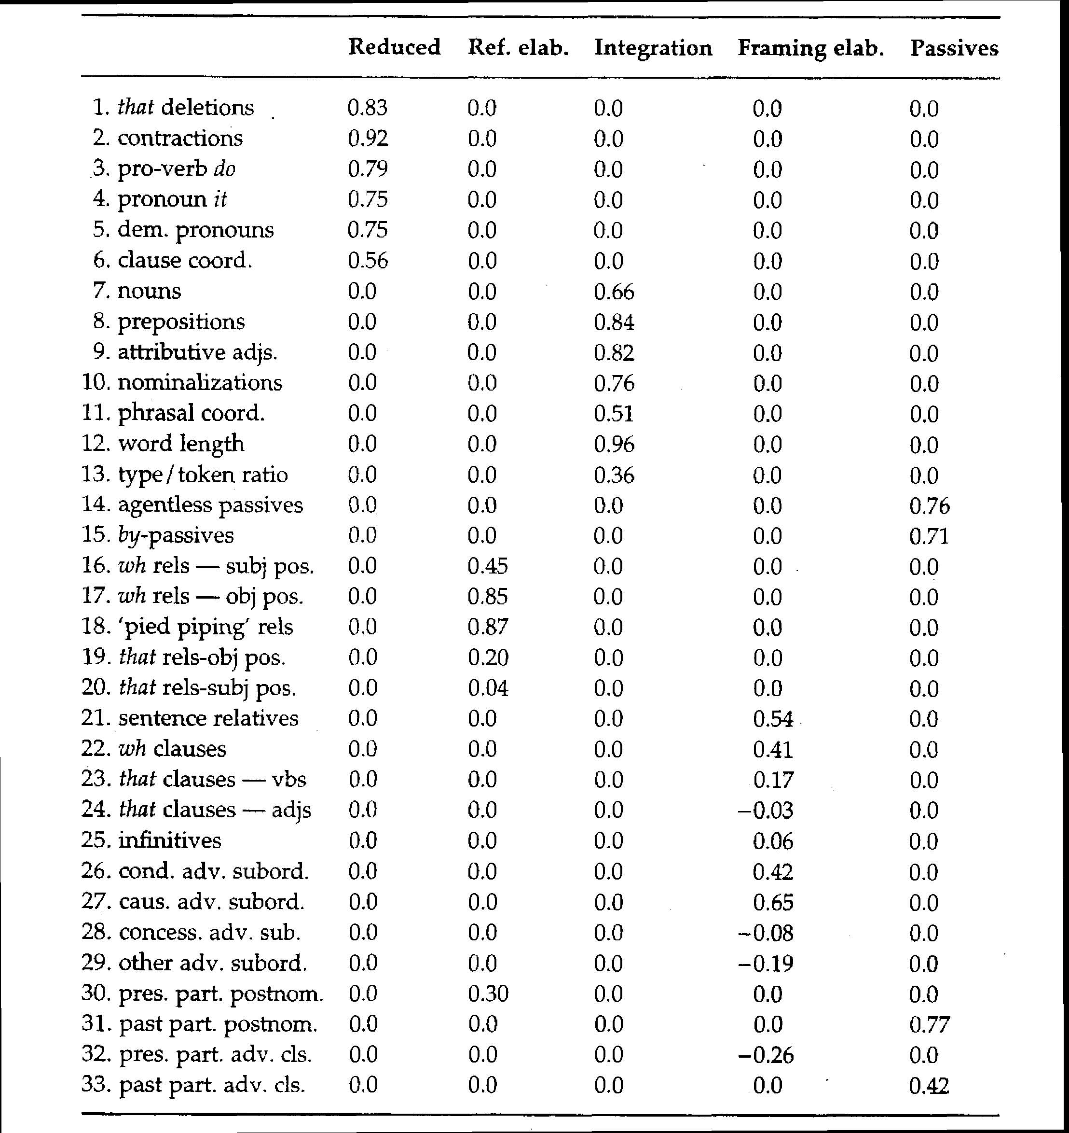
Biber 1992:

Slide 25
Defining Grammatical Complexity
Mean length of utterance (MLU)
Number of verb phrases per sentence
Ratio of dependent clauses to total number of clauses
Number of clauses per sentence
N. Iwashita et al. (2008) Assessed Levels of Second Language Speaking Proficiency: How Distinct?. Applied Linguistics 29/1: 24 – 49.

Slide 26
 | Target Tense |  | Total Count |  | Raw Count
 | Npa (%) | DPr (%) | Npa | DPr | Npa | DPr
YmtqVE | 70.51 | 81.40 | 78 | 43 | 55 | 35
cSUJtE | 68.09 | 83.33 | 47 | 36 | 32 | 30
FkXZyu | 60.61 | 100.00 | 33 | 27 | 20 | 27
IhmZSm | 50.00 | 57.58 | 8 | 33 | 4 | 19
qEqUJu | 47.62 | 85.71 | 21 | 35 | 10 | 30
KRzMXq | 44.44 | 89.47 | 18 | 19 | 8 | 17
qEqUJu | 41.07 | 100.00 | 56 | 8 | 23 | 8
QCJFSC | 38.24 | 86.67 | 34 | 30 | 13 | 26
IOLJvw | 25.00 | 100.00 | 8 | 10 | 2 | 10
kZRObu | 15.00 | 93.33 | 20 | 15 | 3 | 14
CqyPcO | 13.04 | 95.56 | 23 | 45 | 3 | 43
RvfdlV | 6.67 | 83.33 | 15 | 12 | 1 | 10
eLaUsh | 4.00 | 93.33 | 25 | 30 | 1 | 28
JbpGeI | 0.00 | 93.94 | 54 | 33 | 0 | 31
Use of Past Tense in PN
Use of Present Tense in DPr

Slide 27
Past + Present
Use of
Past Tense in Past Narrative
Vs
Present Tense in Present Description

Slide 28
Past Narrative
TASK: narrate in the past
Situation: You and a group of friends are talking about cell phones and how much you depend on them. One of your friends reminds you that people haven't always had cell phones. She asks you to talk about how life was different before there were cell phones.
Prompt: So, how did we all get along before we had cell phones?

Slide 29
Past Narrative: JbpGeI
Yeah life is life is a quite different from people have we have phones and we don’t have phones. Before we don’t have phones. People can they don’t know lots of information. They can’t get some information. {We} assume they need to wait for others to tell them. To gain information from others by {hosting} by by by delivering. or Just by [?] just by [?] to talk about each other. Long distance. To talk about that time that place. But when we when people when we gather. When we have cell phones in our life. Life become more easier. And also People can People have a very enjoyable life. As a time. And Also Like when you when you are have some emergency. You should you contact with your friends or parents. You can you can call them immediately… (354 words)

Slide 30
Reflective Teaching
The Computerized Assessment of Proficiency (CAP) is based on benchmarks consistent with the ACTFL Performance Guidelines, which foster a more consistent learning environment from one classroom, school, or district to the next. Designed to be independent of specific textbook or curriculum, CAP is intended to facilitate reflective teaching and staff development.
CASLS: University of Oregon

Slide 31
Recommendations
Track content areas given to students so no content area is duplicated and for reliability.
Ensure every grid is filled with one representative item.
Hold Summer Institute on assessment as tool for curriculum development.

Slide 32
Recommendations
4. Apply procedures to MSA, Iraqi, Egyptian, and Persian:
Range of vocabulary and word complexity
Syntactic complexity
Grammar of past narration

Slide 33
Thanks for attending
Feedback: shanklin@mail.sdsu.edu

